Slide 1
Kelompok 7
RENTAL VCD
Sera Vika Eviana (672018025)
Leonardo Wahyu Pratama (672018036)
Devi Ariella Susanto (672018037)
Ivan Sukma Hanindria (672018048)

Slide 2
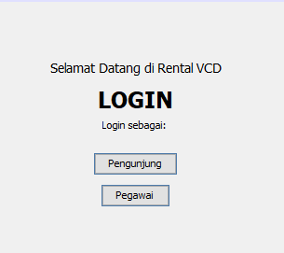
WELCOME PAGE

Slide 3
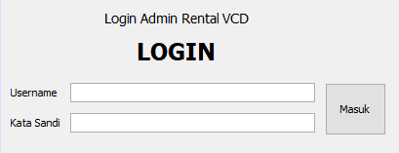
LOGIN ADMIN

Slide 4
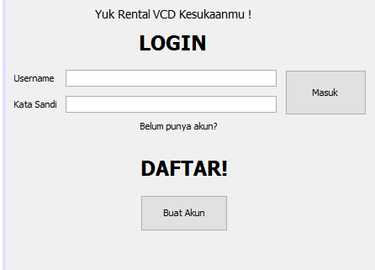
LOGIN PELANGGAN RENTAL

Slide 5
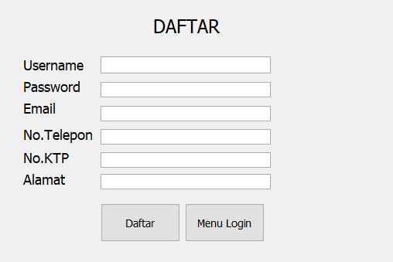
SIGN UP (DAFTAR PELANGGAN RENTAL)

Slide 6
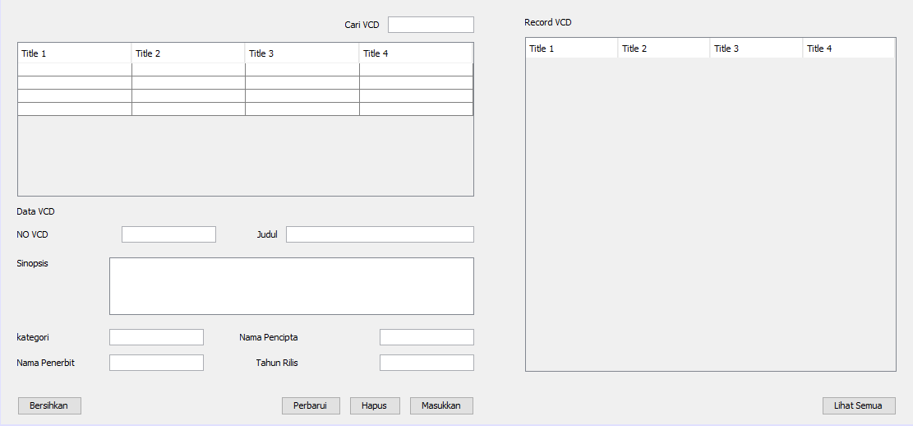
DASHBOARD PEGAWAI

Slide 7
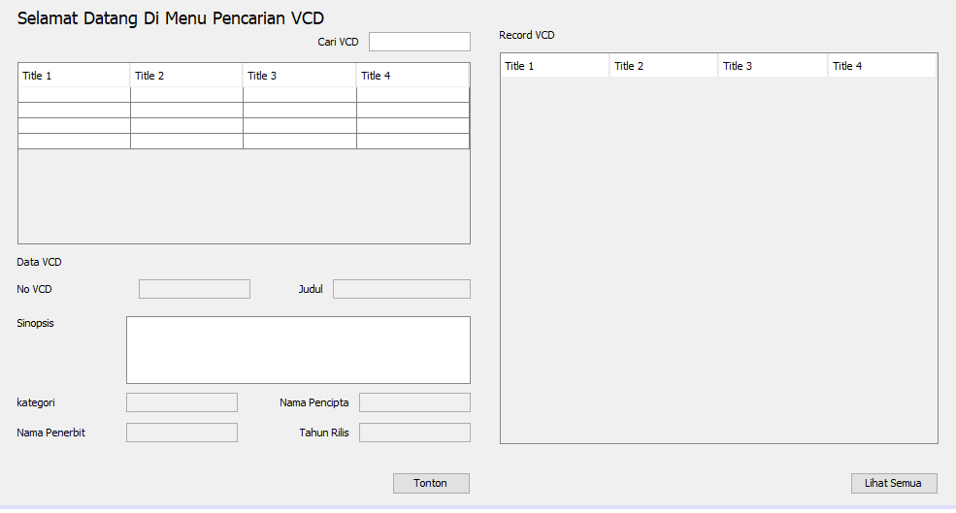
DASHBOARD PELANGGAN RENTAL

Slide 8
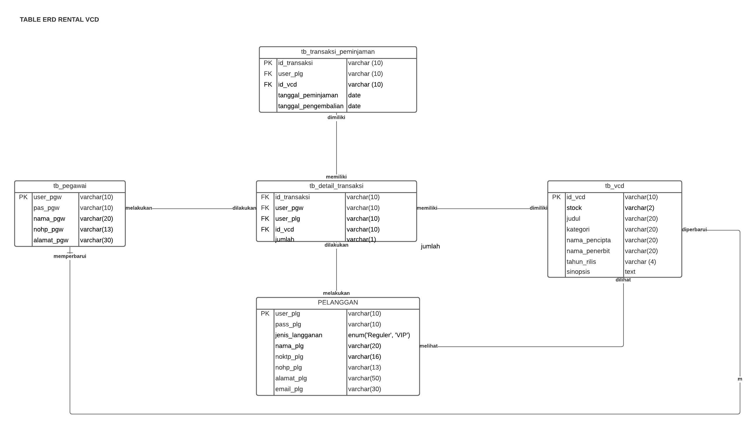
STRUKTUR DATA & RELASI

Slide 9
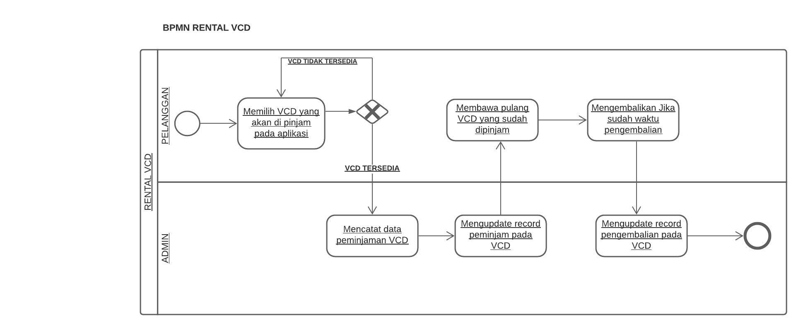
BUSINESS PROCESS MODEL AND NOTATION (BPMN)

Slide 10
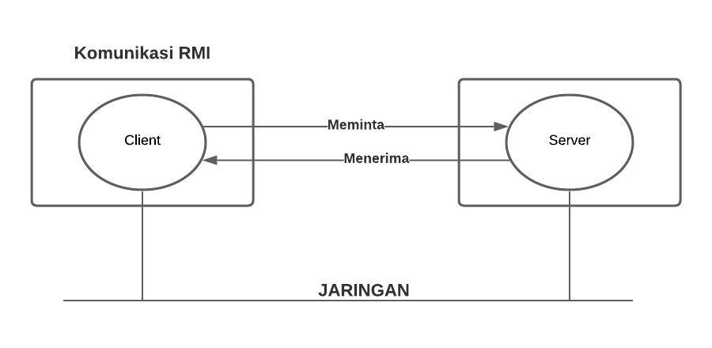
CARA KOMUNIKASI RMI

Slide 11
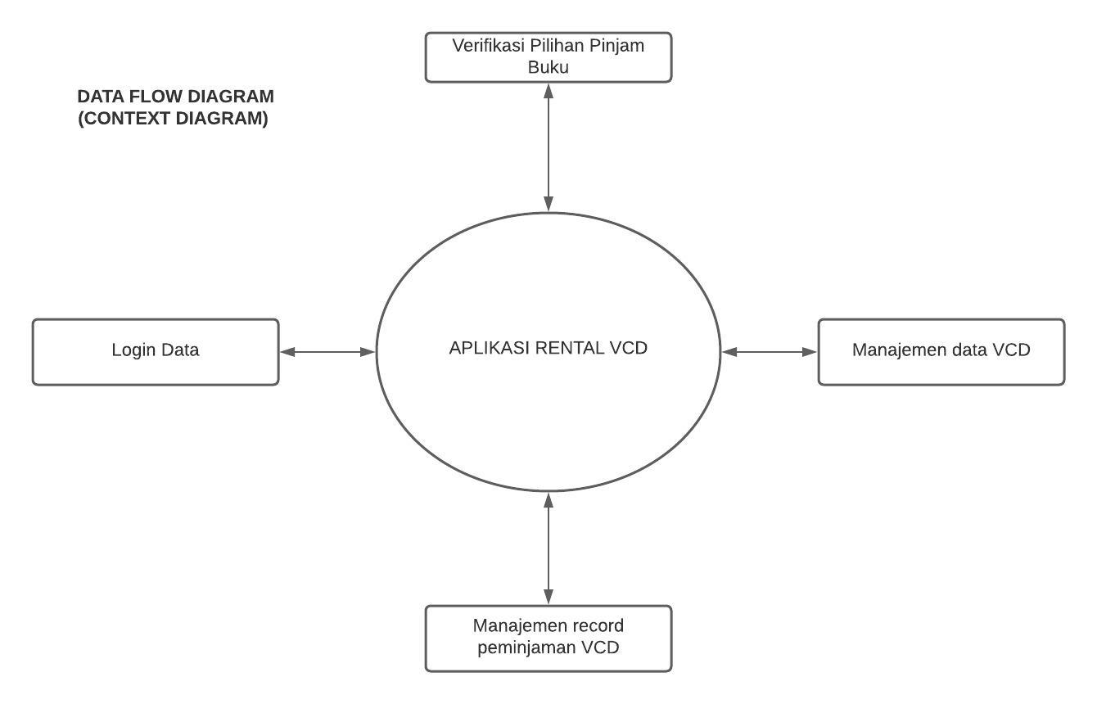
DATA FLOW DIAGRAM (CONTEXT DIAGRAM)

Slide 12

TERIMA KASIH

